Slide 1
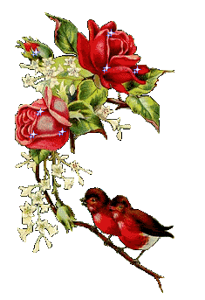
Lesson:
”Customs and traditions of Kazakhstan and Great Britain”

Slide 2
Сабақтың мақсаты:
Білімділік мақсаты (Educational aim) :Қазақстан мен Ұлыбританияның салт- дәстүрі мен әдет- ғұрпы, наным- сенімі туралы мағлұмат беру. Оларды өзара салыстыра отырып, ерекшеліктерін ашып көрсету, білімдерін толықтыру.
Дамытушылық мақсаты( Development aim): Студенттердің пәнге деген қызығушылығын арттыра отырып, олардың логикалық ойлау қабілеттерін арттыру, жаңа сөздермен таныстыра отырып, сөздік қорын байыту. Дұрыс сөйлеу мен жазу дағдыларын дамыту.
Тәрбиелік мақсаты (Upbringing aim): Өзге елдің салт- дәстүрін құрметтеуге, өз еліміздің әдет- ғұрпы мен наным сенімдерін қадірлеп-қастерлеуге, мақтан етуге тәрбиелеу.

Slide 3
I.Ұйымдастыру кезеңі
(Org moment):
-Good morning, students! I am glad to see you! How are you?
- Who is on duty today?
- What day is it today?
- Who is absent?
- Sit down, please! Thank you!

Slide 4
II.Үй тапсырмасын тексеру
( Questions) Сұрақтар:
- What is the capital of Kazakhstan?
-What is the population of Kazakhstan?
-What large cities of Kazakhstan do you know?
-What countries does it border on?
-What do you know about Almaty?
-What parks of Almaty do you know?
-Do you like to go to the parks?
- When was Medeu built?
- What do you know about Shymbulak?

Slide 5
III.Жаңа материалды меңгерту
Ой қозғау. (видеоролик көрсету)
- What did you see in this video? -What it is told here about?
Бір студенттен жауап алынады.

Slide 6
2. Жаңа сөздермен таныстыру
superstition- наным, сенім
contradictory- кері, қарама-қарсы
believe- сену
belief- сенім
cauldron, kazan- қазан (ыдыс)
spill- төгу, шашу
slip- қолдан шығып кету, түсіріп алу
scanty- жеткіліксіз
horse mane- аттың жалы

Slide 7
trim – кесу, тегістеу
mourning – қайғалы
destiny-тағдыр
escape- кету
pregnant woman- аяғы ауыр, жүкті әйел
epic –эпикалық
preserve- сақтау, сақталу
improvise- айтысу
folklore-фольклор
publicist-публицист, журналист

Slide 8

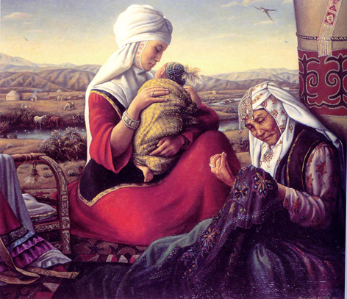
Kazakh superstitions and beliefs
A large number of Kazakh beliefs and superstitions can hardly be applied to modern life. The majority of them came from ancient times, even naturally become a part of today’s life, or, at least, can add a lot to our knowledge of Kazakh culture.

Slide 9
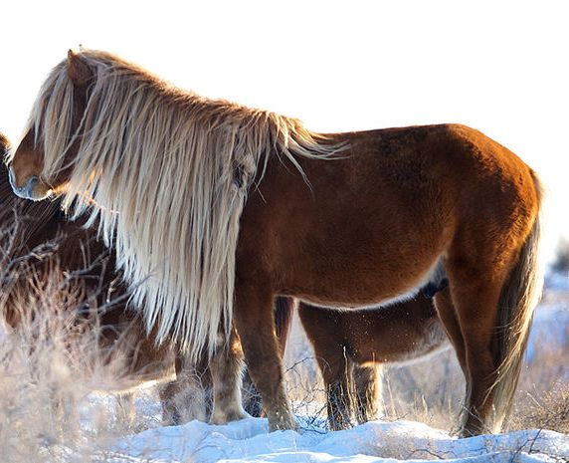
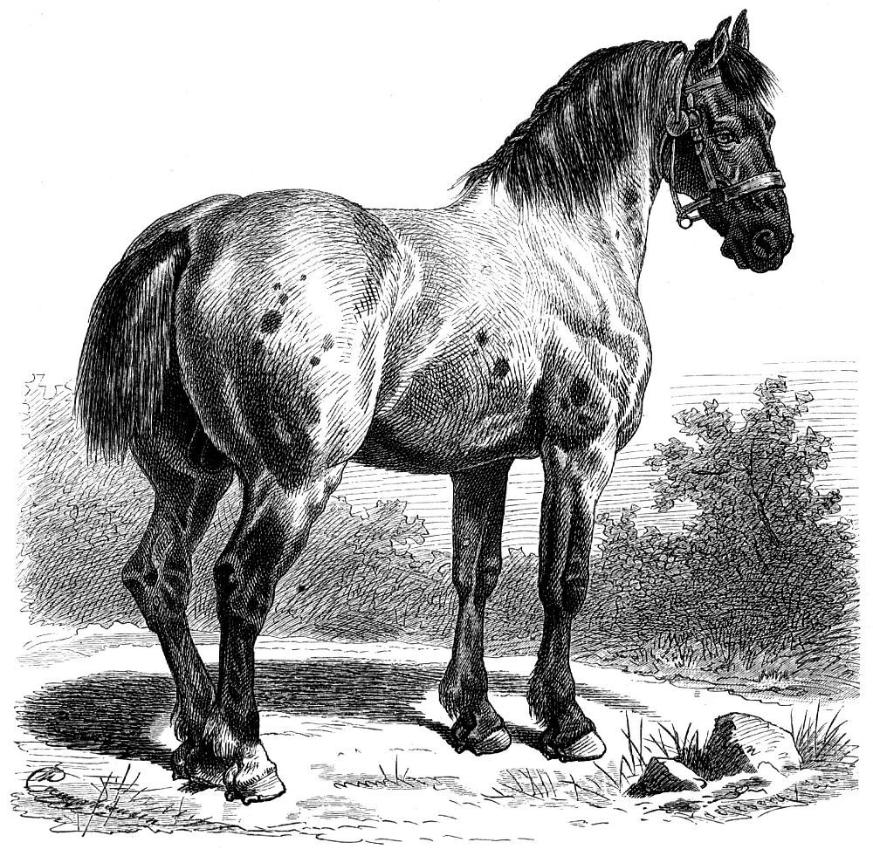
Usually, horse mains and tails are not trimmed, to make sure the horse’s owner enjoy good health.
When a horse owner dies, people will trim the mane and the tail of his horse to make it look mournful. Therefore, the Kazakh associate the trimmed mane and tails of their horses with mourning and death.

Slide 10
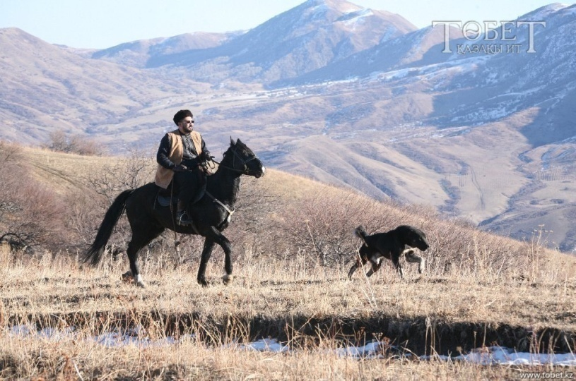
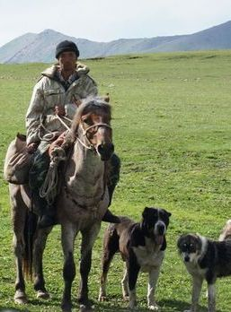
If a dog follows a horseman leaving his village, people would not try to force it back.
The dog is devoted to its owner, and if it wants to go with him it means he will have a happy trip.

Slide 11
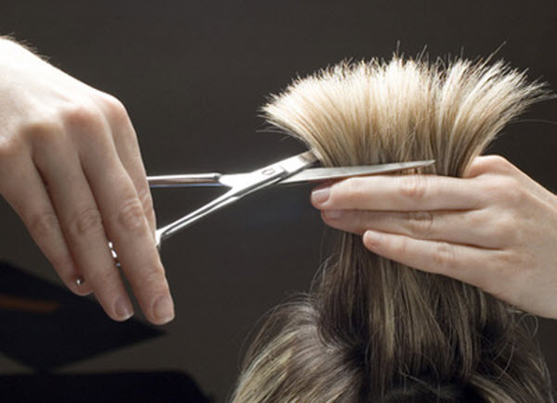
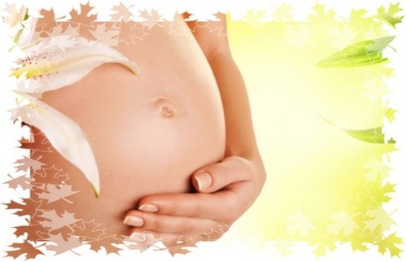
A pregnant woman cannot have a haircut because it may hurt her motherhood, and the happiness of the child she is having.

Slide 12
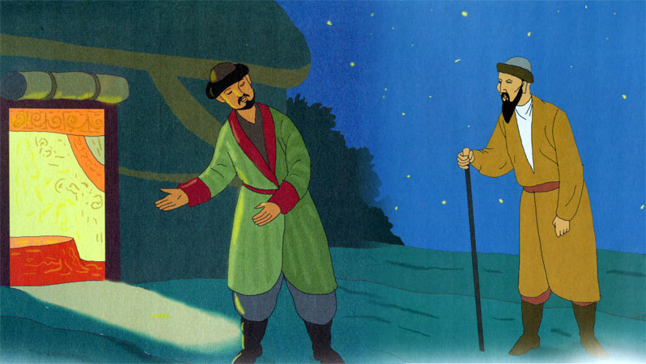
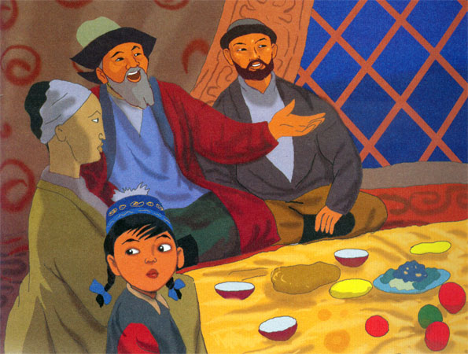
If you have a visitor during your breakfast, he or she must have some of your food. There is a saying: “One cannot ignore the morning meal” and “If you don’t have breakfast, the community will refuse you”. Therefore , a morning guest can leave your home after he or she has tried some of your food. “Food is men’s support ”.
Breakfast is the beginning of a day. Kazakh believe that a good and well prepared breakfast eaten in a good humoured atmosphere can be a good beginning for a successful and fruitful day.

Slide 13
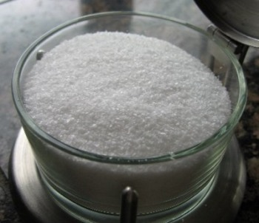
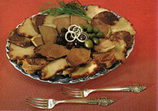
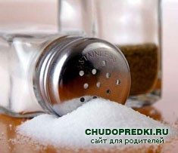
Kazakhs are always careful with salt. Food would be tasteless without salt.
Kazakh’s believe that “the essence of food is in its salt”.
Lives of those who have been careless with salt will become salty and bitter until the salt spilt by them dries out.

Slide 14
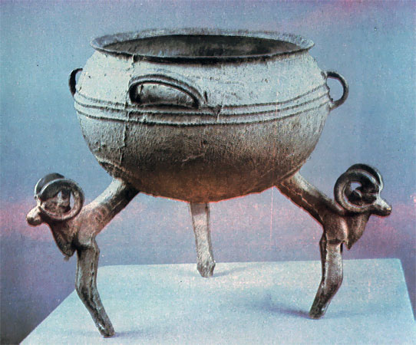
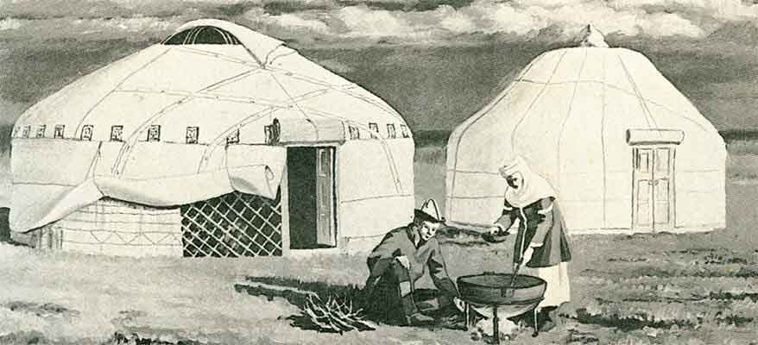
A cauldron/kazan can not be left facing the entrance door. It is bad luck if a cauldron slips and falls. It means your destiny is escaping , your very well-being is lost, food becomes scanty.

Slide 15
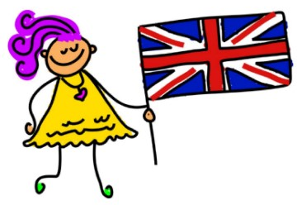
British stereotypes, beliefs and superstitions

Slide 16
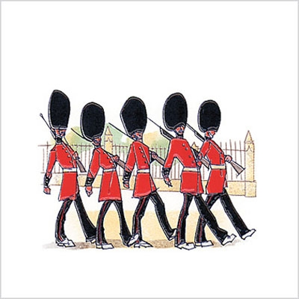
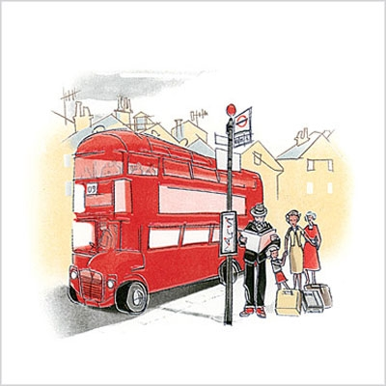
The British, like other people, are given certain characteristics, which are supposed to be typical. These characteristics are called stereotypes.
The first and the main stereotype about Britain is that it is the land of tradition.
Actually, that is partly true, because British traditions are carefully kept within the country, but on the public level.

Slide 17
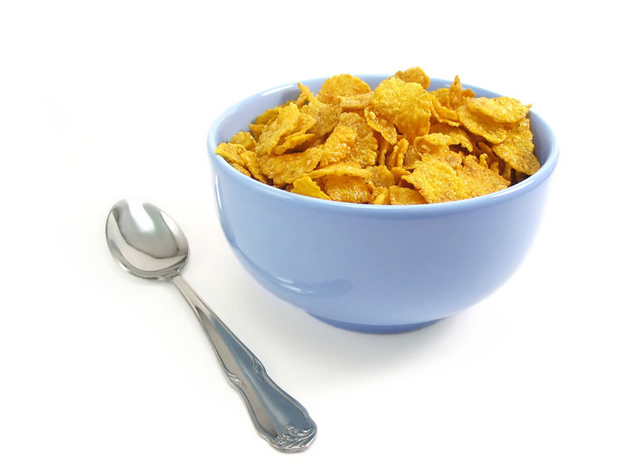

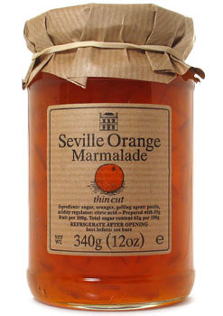
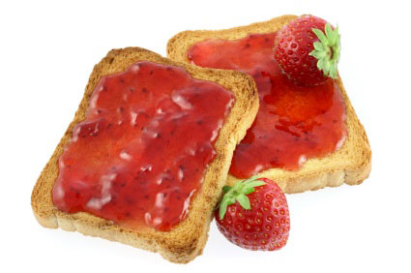
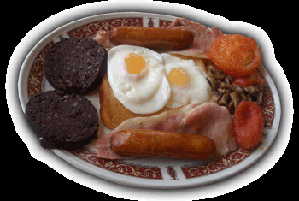
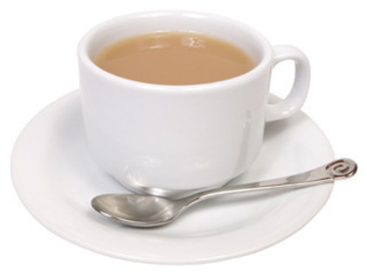
Food is another example.
The British are believed to eat the traditional "British" (or "English") breakfast which consists of fried bacon and eggs, cereals, toast with jam or marmalade, and lots of tea.

Slide 18
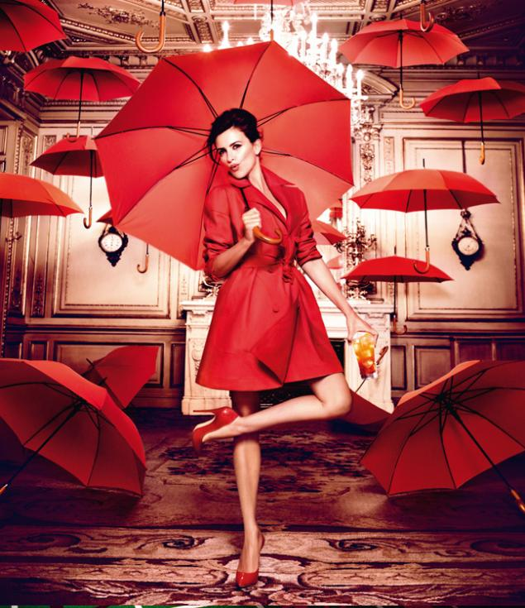
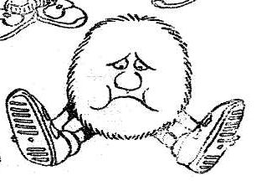
The British believe that …
You must not open an umbrella inside a house for it may bring bad luck to you.

Slide 19
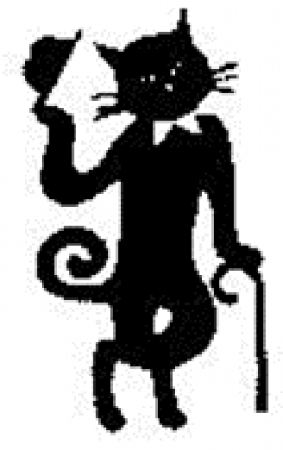
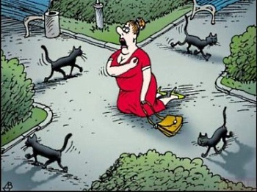
The British believe that …
«If a black cat crosses your path, you will have good luck».
for Russian and Kazakh
for the British

Slide 20
Solve the Crosswords (сөзжұмбақ шешу). Жауаптарын студенттер кезектесіп жазады.

Slide 21
( Questions) Сұрақтар:
1) Translate the word “салт- дәстүр”
2) Folk Art of the Kazakh?
3) Who was Akhmet Baitursunuly?
4) Our Motherland?
5) Superstitions- do you--------- in them?
6) British holiday?

Slide 22
IV.Сергіту сәті. The game « Clap-clap»
Қол соғу ойыны.
Мұғалім бірнеше сөздердің тізбегін оқиды. Соның ішінен мемлекет аттары кездескенде студенттер қол соғулары керек.
House, plane, table, Kazakhstan, door, moon, museum, USA, park, book, London, animals, place, Great Britain, gas, capital, sport, The Russian Federation, cook, apple, son, China, day, school, work, Scotland.

Slide 23
V. Protection of the presentation
( Презентацияны қорғау)
Топтық жұмыс
Әр топтан студенттер кезектесіп шығып, бір салт- дәстүрді таныстырып өтеді.

Slide 24
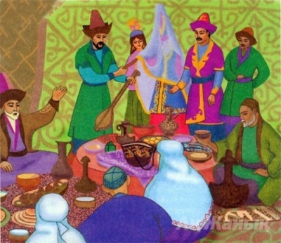
Betashar
The beautiful custom of Betashar- the ceremony of uncovering bride’s face. A bride, her face covered with a veil, is introduced to her bridegroom’s relatives. The toast- master of the festival, usually n akyn, introduces all the guests to the bride (often with a song).

Slide 25
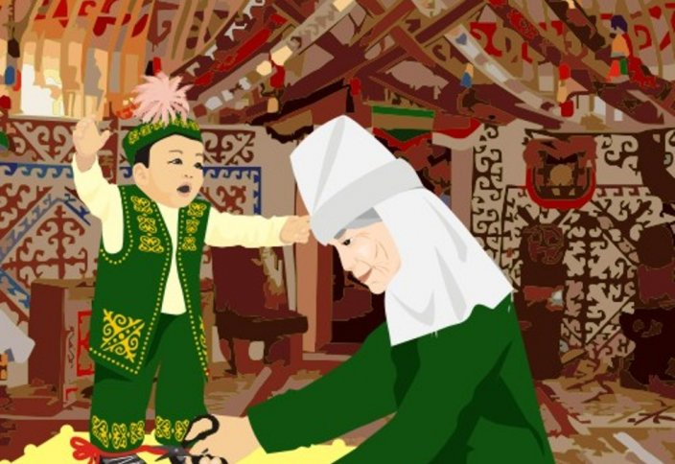
Hobbles cutting
When a baby begins to walk, he undergoes another ancient rite- the hobbles cutting.
A hobble of rope round a child’s legs is tied. It looks like a figure- of- eight. The child has to make a few steps and then the hobbles are cut with knife by the most respected guest.

Slide 26
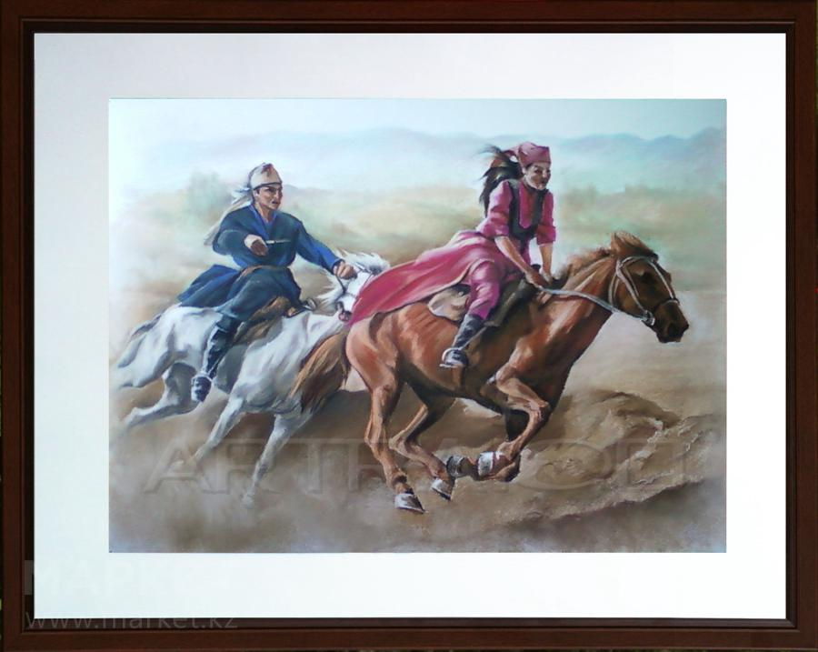
Kyz kuu
It this race a young girl- rider starts first. All participating jigits then followed trying to catch her. When the luckiest of them caught up with the girl, he snatched a headscarf out of her teeth. If he failed to do this before the finish, then the girl turned her horse around and whipped the loser who must try to escape her lash.

Slide 27
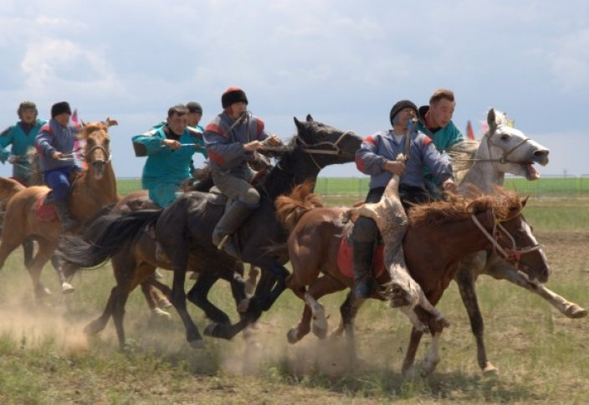
Kokpar
In addition to traditional horse-races during festivals and feasts, the game Kokpar- was usually played. One of the horse- rides with goat’s carcass in his hand raced far ahead. Other paticipants in the game followed him. A champion-to-be had to have a quick horse to catch up with the jigit with the goat’s carcass.

Slide 28
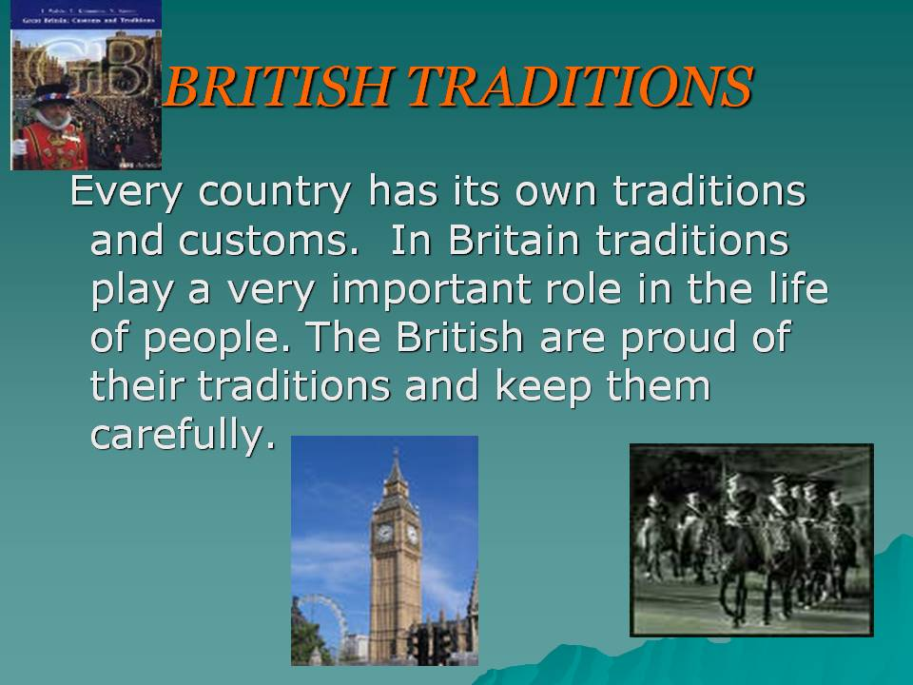

Slide 29
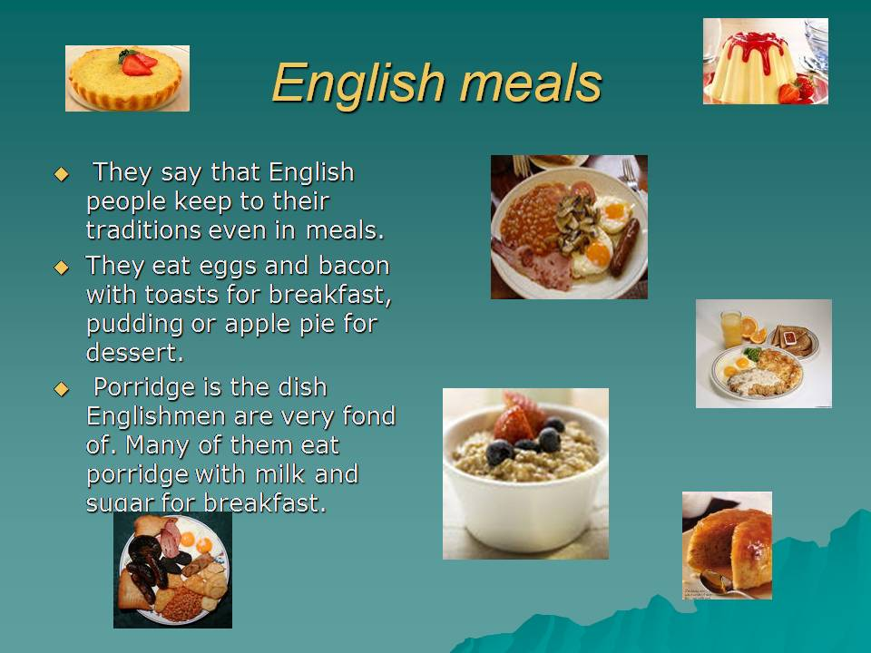

Slide 30
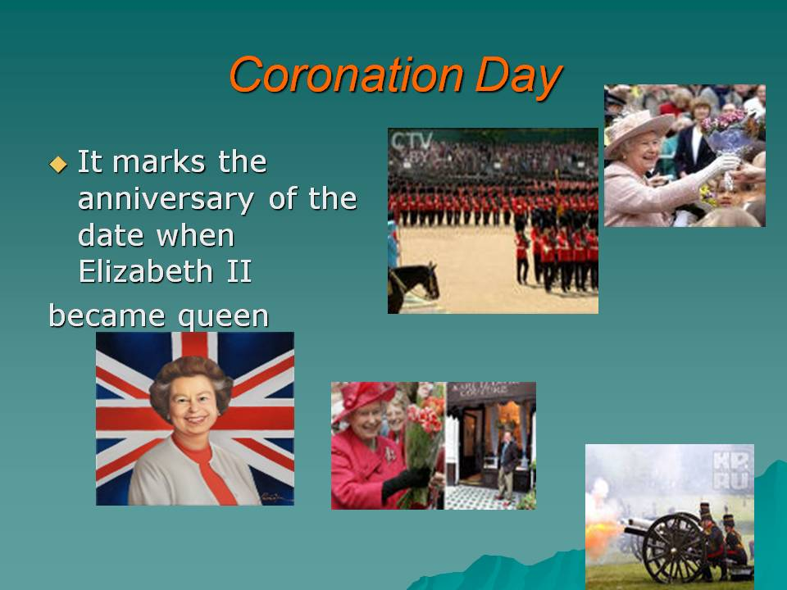

Slide 31
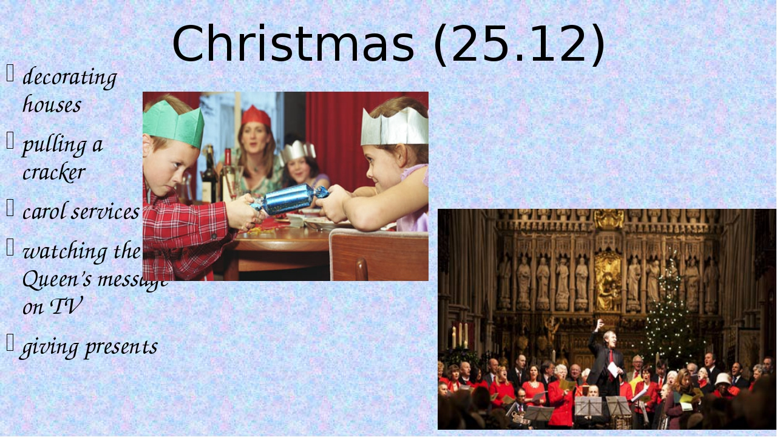

Slide 32
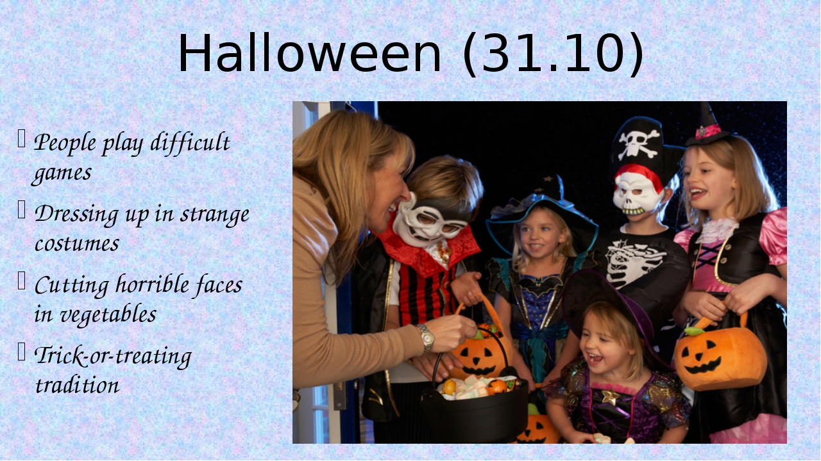

Slide 33
VI. Деңгейлік тапсырмалар
1- деңгей тапсырмасы. Ex 6 (b) Complete the exercise. Берілген жұрнақтар бойынша зат есімнен сын есім жасау қажет.
2 -деңгей тапсырмасы.
The cluster (Кластер құрастыру)
3- деңгей тапсырмасы.
To make a dialogue.(Диалог құрастыру)

Slide 34
VII.Жаңа материалды бекіту. «Construct a sentence» Топтық жұмыс.
Студенттерге бірнеше жеке сөздер салынған конверт үлестіріледі. Екі топқа екі конверт беріледі. Топтағылардың тапсырмасы дұрыс сөйлем құрастыру.

Slide 35
VIII.Үй тапсырмасын беру.
« Customs and traditions» тақырыбына қосымша мәліметтер жинастыру. Vocabulary

